Slide 1
Discrete Structures
Instructor: Zubaria Asma
Course Code: CS-335
Credit Hours: 3(3-0)
Lecture # 19

Slide 2
Sequence

Slide 3
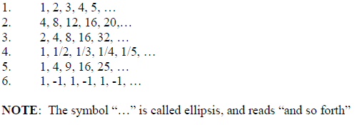
SEQUENCE:
A sequence is just a list(ORDER) of elements usually written in a row.
EXAMPLES:
Notes:
e.g. 2nd is the multiple of 4 is the domain
4th is the rational no.

Slide 4
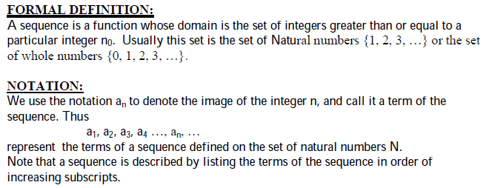
SEQUENCE:
Notes:
SEQUENCE IS A FUNCTION WHOSE VALUES BELONG TO SOME DOMAIN
e.g. 2nd is the multiple of 4 is the domain
4th is the rational no.

Slide 5
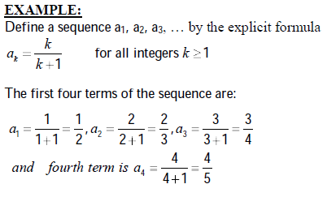
FINDING TERMS OF A SEQUENCE GIVEN BY AN EXPLICIT FORMULA:
Notes:
WE HAVE TO FIND TERMS BY USING GIVEN FORMULA….
E.G. START FROM THE K=1 FOR FINDING 1ST TERM
SO WE ARE FINDING SEQUENCE THROUGH THE GIVEN FORMULA

Slide 6

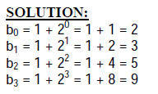

FINDING TERMS OF A SEQUENCE GIVEN BY AN EXPLICIT FORMULA:

Slide 7



FINDING TERMS OF A SEQUENCE GIVEN BY AN EXPLICIT FORMULA:
Notes:
If put even no. the answer will be 2 and for odd no. answer will be 0

Slide 8
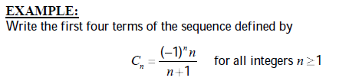
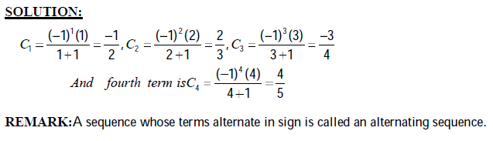
FINDING TERMS OF A SEQUENCE GIVEN BY AN EXPLICIT FORMULA:

Slide 9




Notes:
Lets GENERATE a formula FOR THE GIVEN SEQUENCE
K-1/k+1,, FIRST TERM IS CREATED but issue in the SECOND TERM OF sequence AND so ON SO lets make another formula TO ACHIEVE THE SEQUENCE
1/k-1/k+1,, this formula make your correct sequence

Slide 10

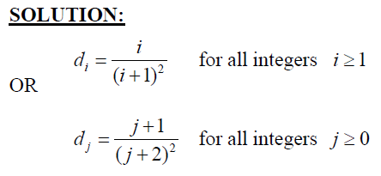

Slide 11
ARITHMETIC SEQUENCE:
A sequence in which every term after the first is obtained from the preceding term by adding a constant number is called an arithmetic sequence or arithmetic progression (A.P.)
The constant number, being the difference of any two consecutive terms is called the common difference of A.P., commonly denoted by “d”.

Slide 12

ARITHMETIC SEQUENCE:
EXAMPLES:
Notes:
THE SEQUENCE WILL BE GIVEN AND WE HAVE TO FIND OURSELVE EITHER IT’S ARITHMETIC SEQUENCE OR ANY OTHER,,
IF COMMON DIFFERENCE EXIST THEN IT WILL CALLED AN ARITHMETIC SEQUENCE

Slide 13
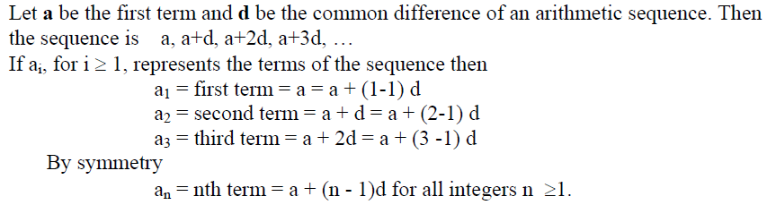
GENERAL TERM OF AN ARITHMETIC SEQUENCE:
Notes:
a=+0d, a+1d, a+2d…
Buth we have to find nth no. through aritmetic sequence(general formula)

Slide 14

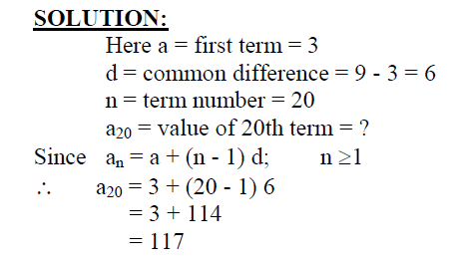
GENERAL TERM OF AN ARITHMETIC SEQUENCE:
EXAMPLE:
Notes:
Difference(2nd term – first term)
an is given but n need to be find

Slide 15
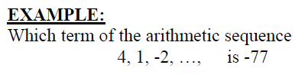
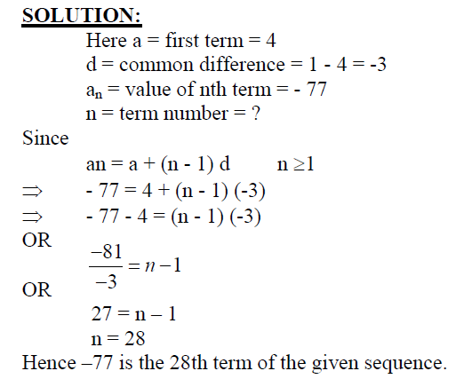
GENERAL TERM OF AN ARITHMETIC SEQUENCE:

Slide 16
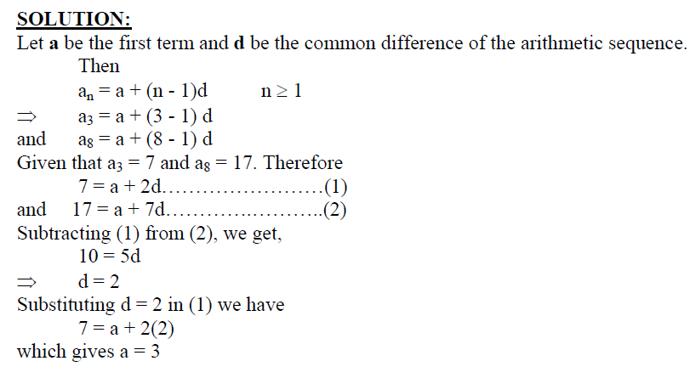
GENERAL TERM OF AN ARITHMETIC SEQUENCE:
Notes:
E got two equations already given(3rd and 7th term)
We don’t given a and d value, so the already information given( we to find the 36th term also)

Slide 17
Do it

Slide 18
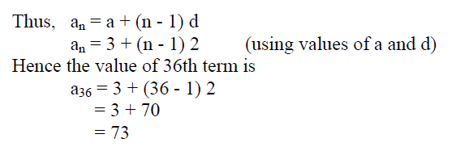
GENERAL TERM OF AN ARITHMETIC SEQUENCE:

Slide 19
The end,,,,

Slide 20
GEOMETRIC SEQUENCE:
A sequence in which every term after the first is obtained from the preceding term by multiplying it with a constant number is called a geometric sequence or geometric progression (G.P.)
The constant number, being the ratio of any two consecutive terms is called the common ratio of the G.P. commonly denoted by “r”.

Slide 21
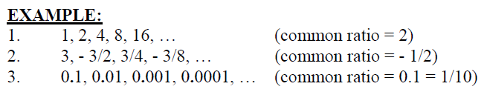
GEOMETRIC SEQUENCE:
Notes:
We have to find the common ration and that value will be multiply with preceeding value

Slide 22
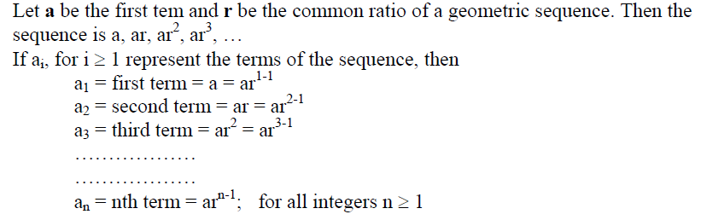
GENERAL TERM OF A GEOMETRIC SEQUENCE:

Slide 23

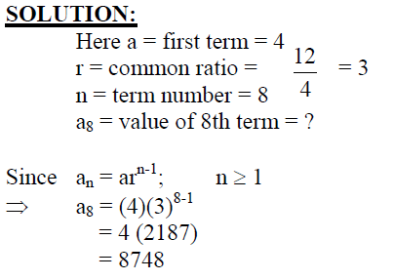
GENERAL TERM OF A GEOMETRIC SEQUENCE:

Slide 24

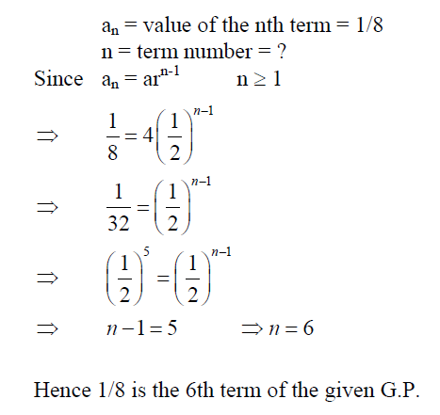
GENERAL TERM OF A GEOMETRIC SEQUENCE:

Slide 25
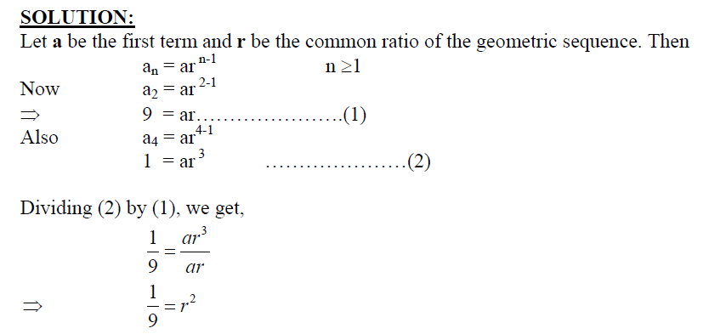
GENERAL TERM OF A GEOMETRIC SEQUENCE:

Slide 26
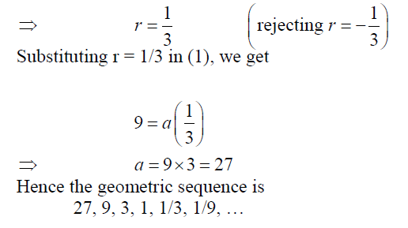
GENERAL TERM OF A GEOMETRIC SEQUENCE:

Slide 27
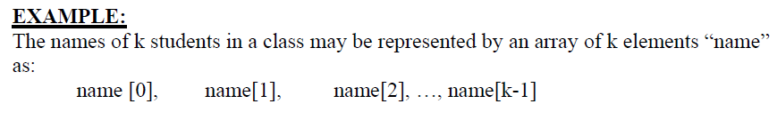
SEQUENCES IN COMPUTER PROGRAMMING:
An important data type in computer programming consists of finite sequences known as one-dimensional arrays; a single variable in which a sequence of variables may be stored.

Slide 28

THANK YOU

